Slide 1



An update to workflows at the Babraham Institute
Felix Krueger
8 April 2020

Slide 2

Previous mode of operation:
Headnode
(Rocks cluster)
jobs submitted to
compute nodes via:
(Stone cluster)
log file
compute
compute
compute
compute
compute
compute
compute
compute
compute
compute
compute

Slide 3
New mode of operation:
Headnode
Workflow watched daemon process:
push logic
pipelines responsive to results
compute
compute
compute
compute
compute
compute
compute
compute
compute
compute
compute

Slide 4

Programming language to handle computational workflows (based on Groovy/Java)
Well suited for complex and highly parallel Bioinformatics workflows
Easy to run/use
[writing pipelines comes with a learning curve]
Handles interaction with compute infrastructure, runs just about anywhere:
Support for software
packaging solutions
Local mode
Batch schedulers
Open grid engine, Univa grid engine, Platform LSF, Linux SLURM,
PBS Works, Torque, HTCondor
Cloud platforms
Amazon Web Services (AWS), Google Cloud Platform (GCP), Kubernetes

Slide 5
Basic concepts
FastQ
FastQ
FastQ
Process 1
publish
Process 2
Process 3
Process 4
input
output

Slide 6
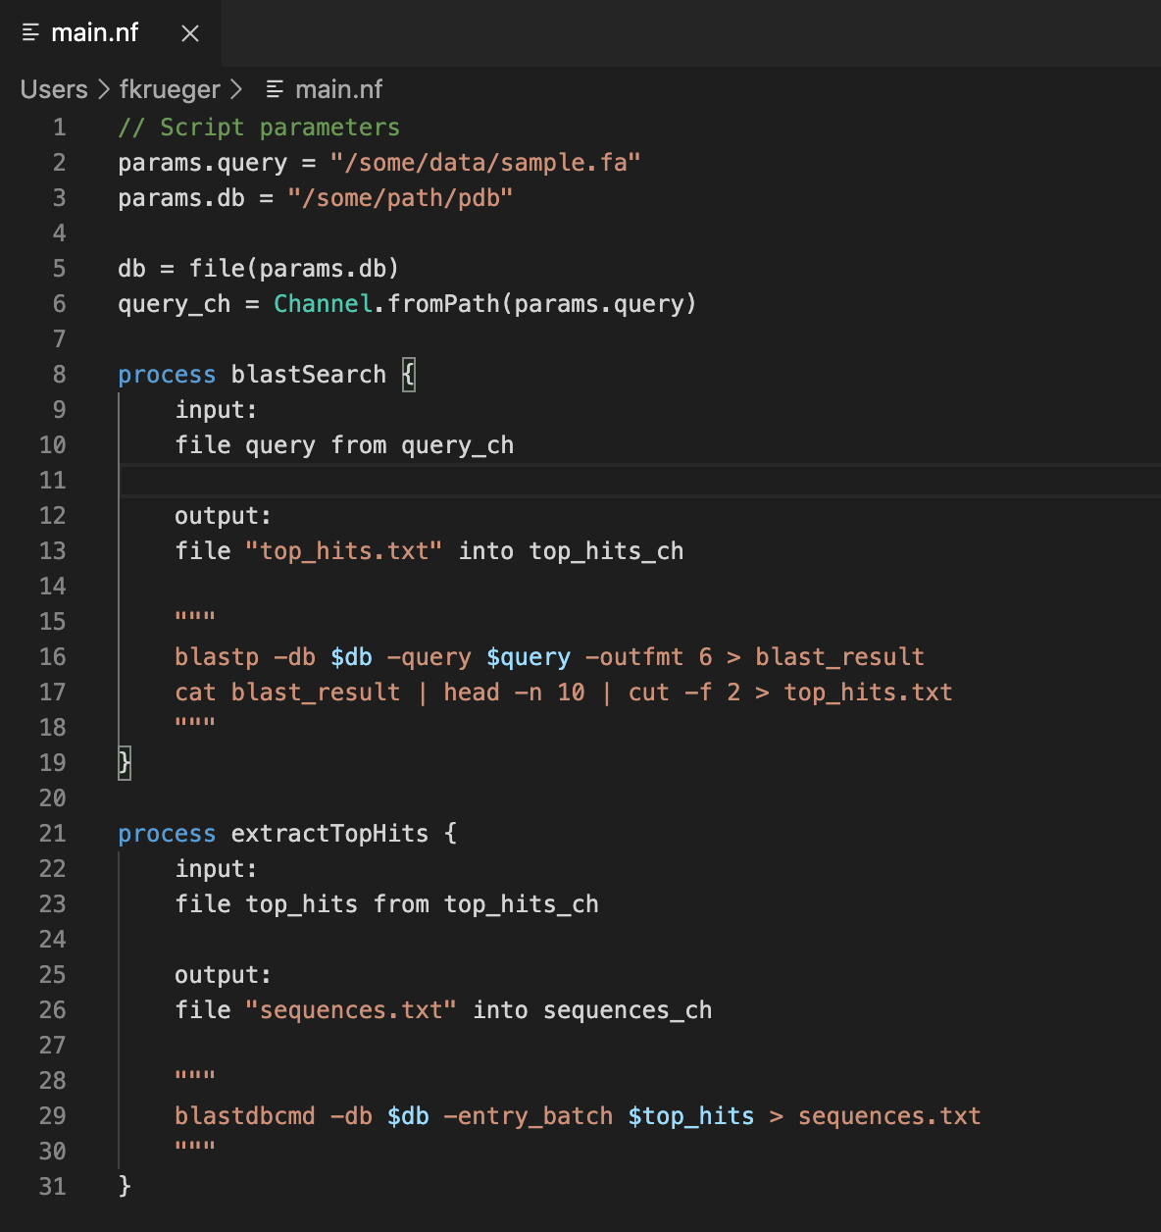
Basic concepts
Process 1
Process 2
Process 3
Process 4
input
output

Slide 7
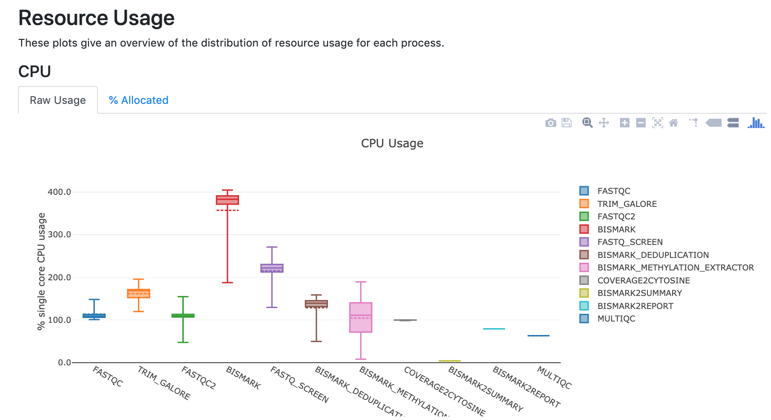
Process execution report

Slide 8
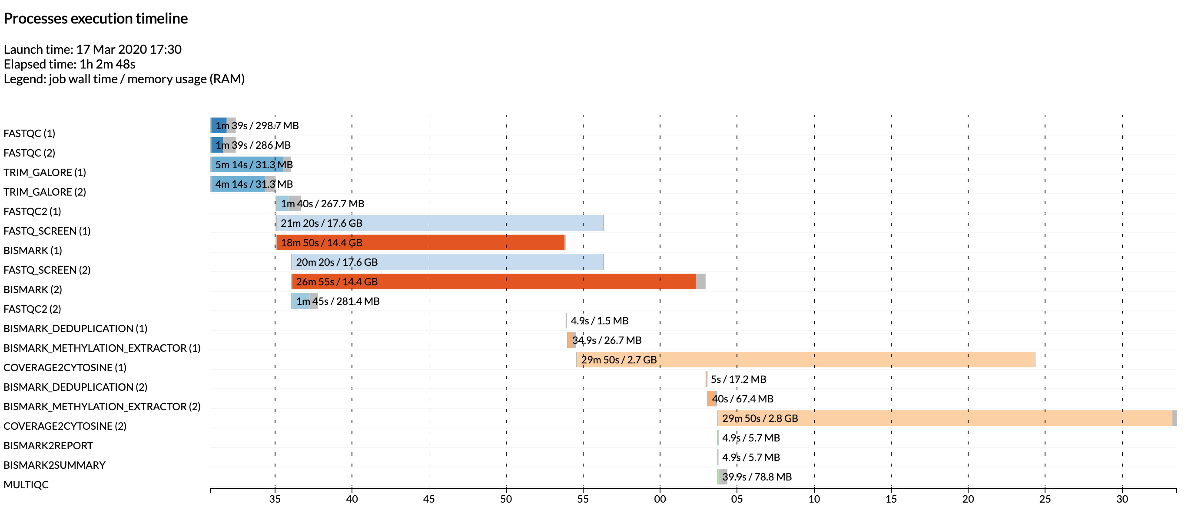
Process execution timeline

Slide 9
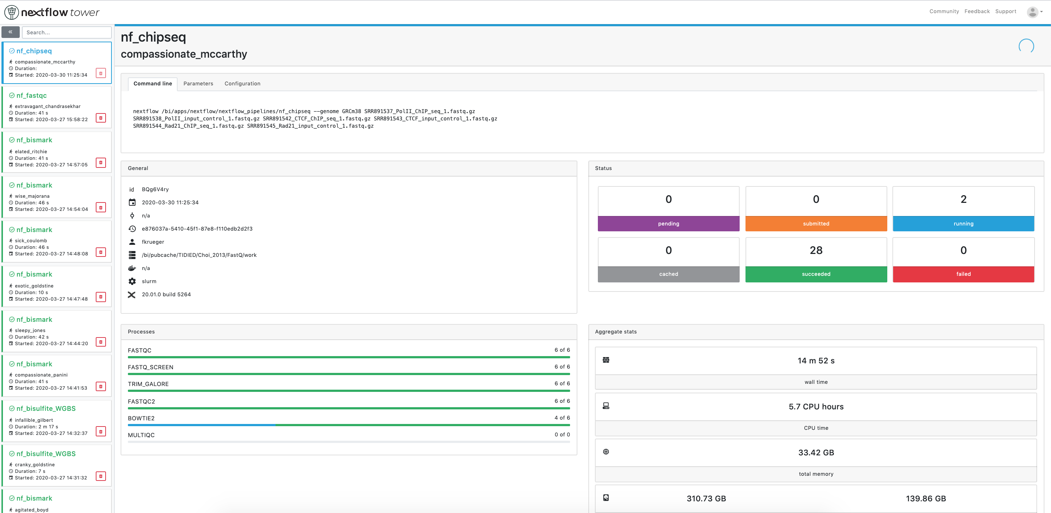
External monitoring with

Slide 10
: Syntax
DSL2
Separation of processes (modules) and their invocation (workflows)
DSL1
(Domain Specific Language)
Entire multi-process pipeline defined as one script
Setting up run and its parameters
Process 1
Process 2
Some logic
Process 3
…
Workflow
Setting up run and its parameters
Step 1
Step 2
Step 3
…
Modules
Process 1
Process 2
Process 3
Mix & match
More legible
Code doesn’t have to be maintained at several different places

Slide 11
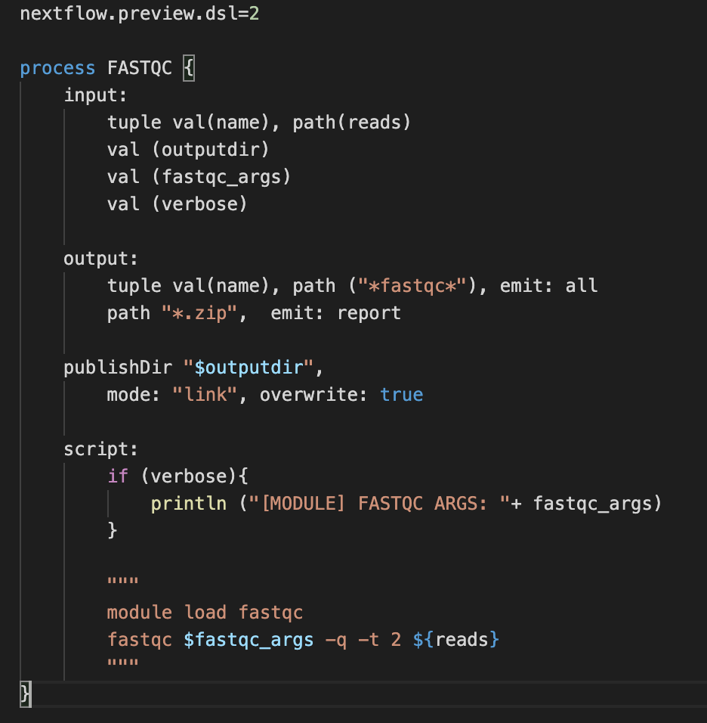
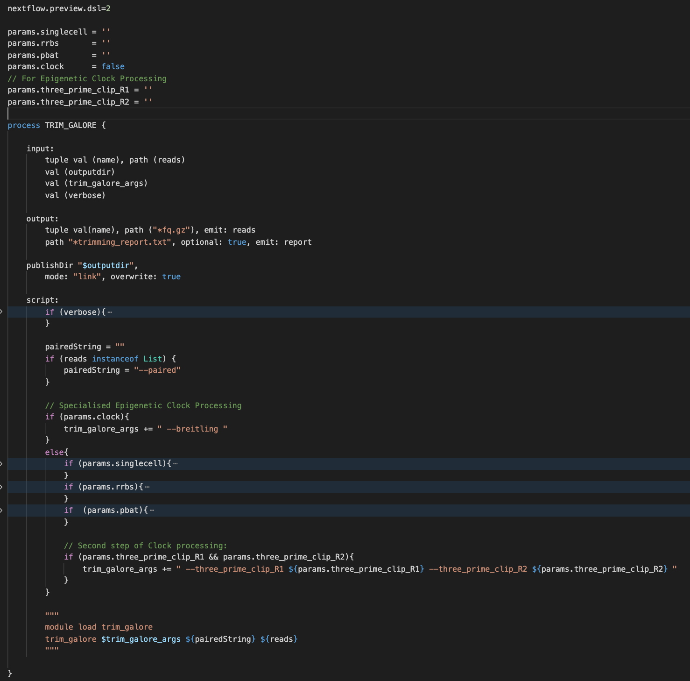
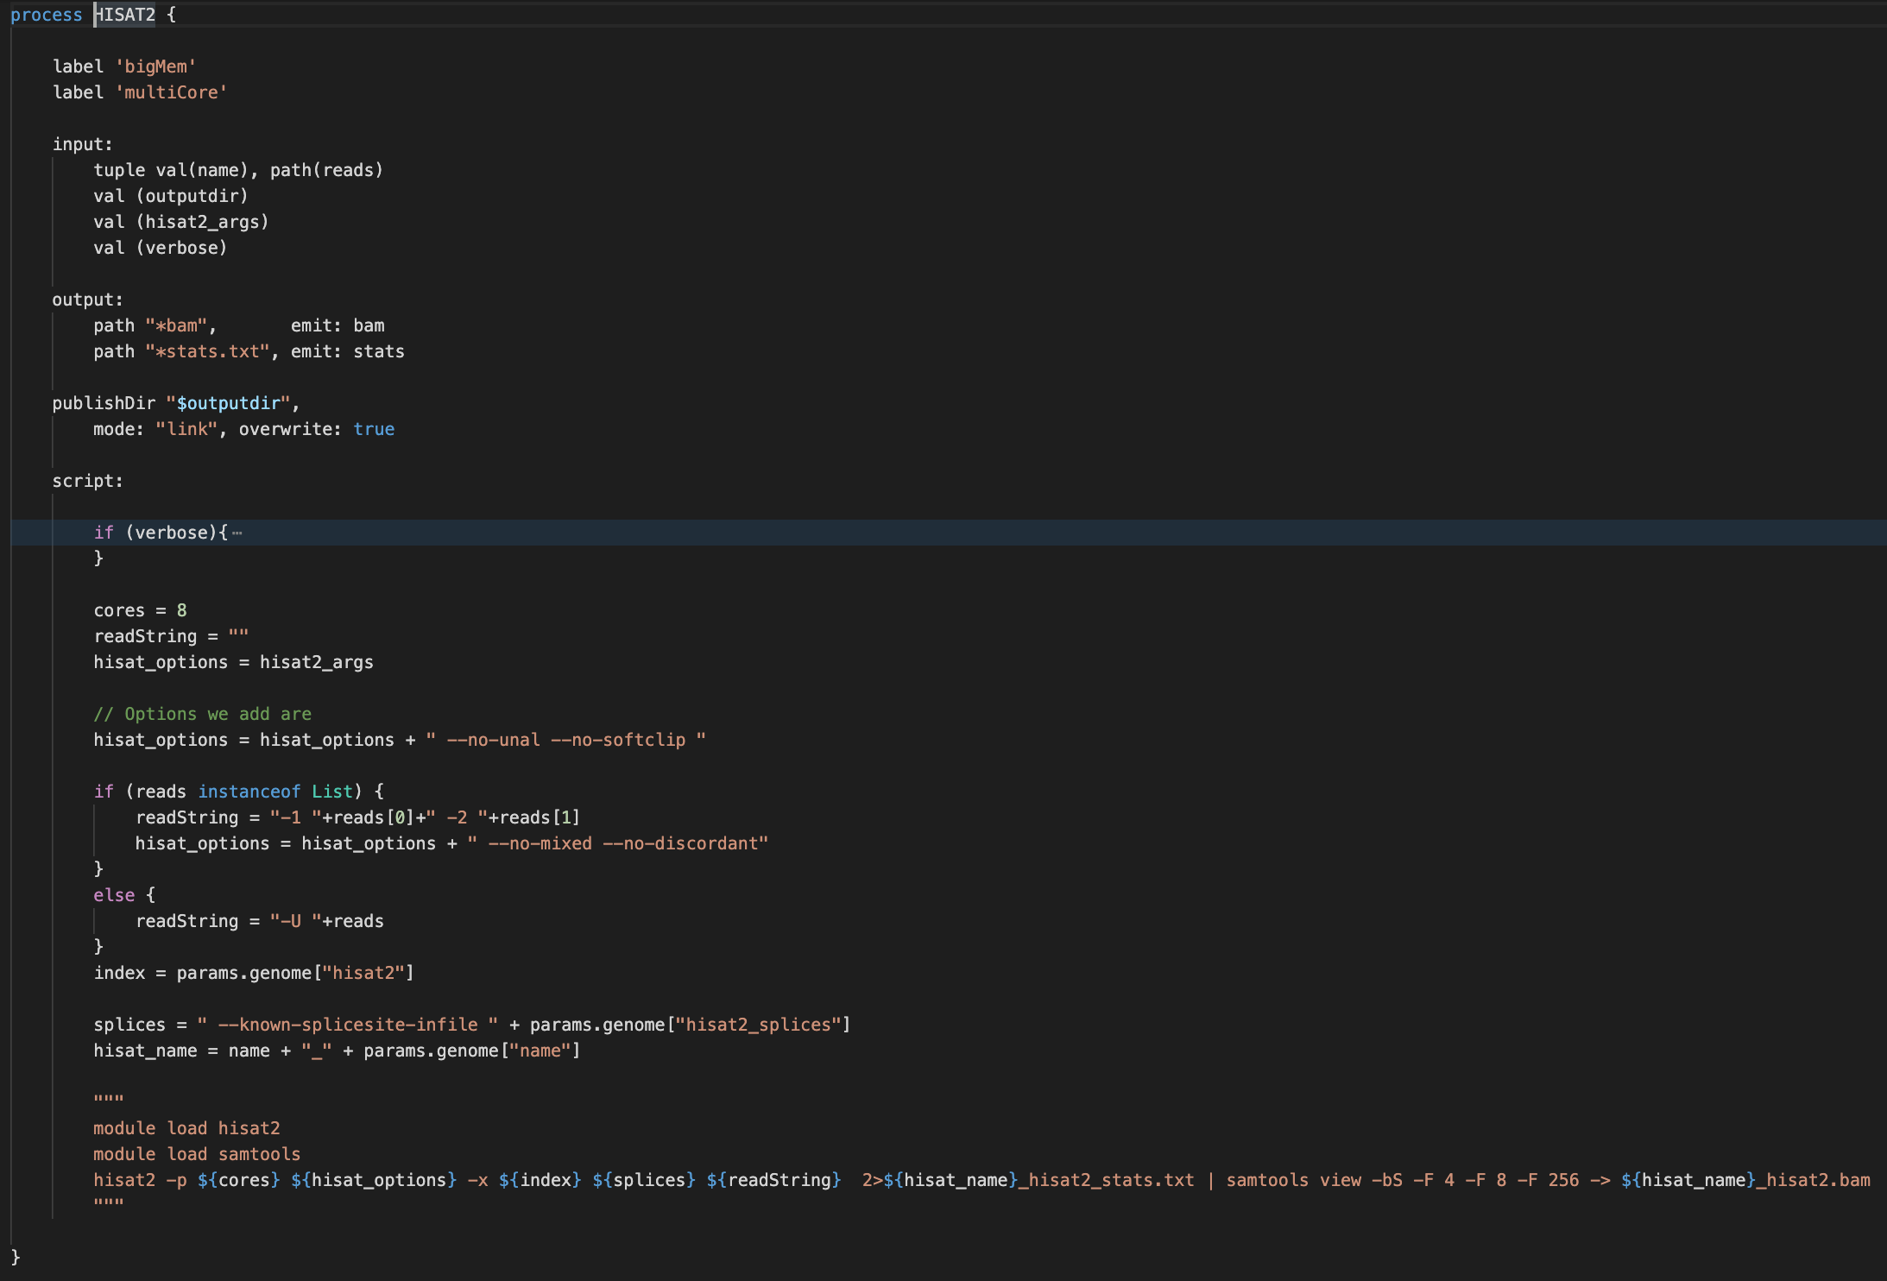
Modules
FastQC
Trim Galore
HISAT2

Slide 12
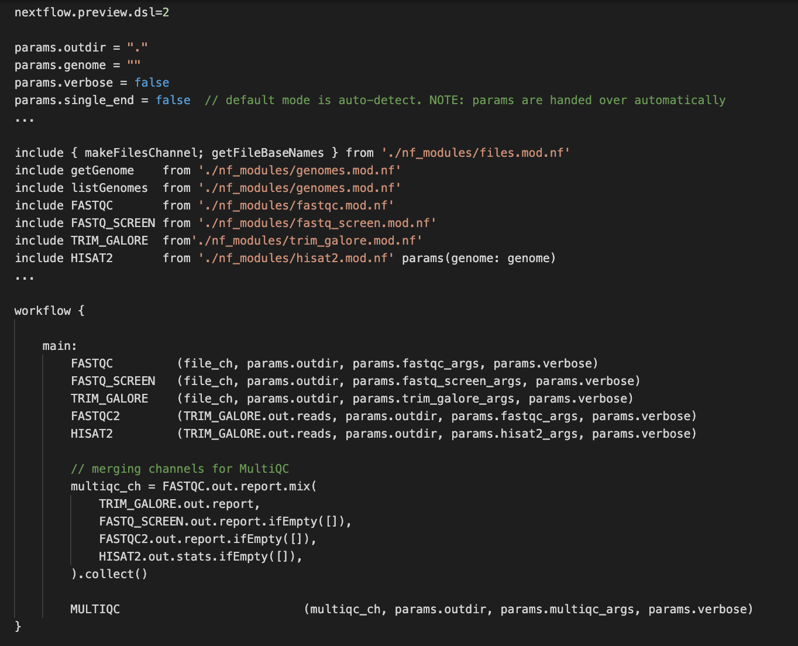
Example RNA-seq workflow

Slide 13
Single tool pipelines
nf_bowtie2
nf_umibam
nf_fastqc
Bowtie2
UmiBam
FastQC
nf_trim_galore
nf_hisat2
nf_snpsplit
Trim Galore
HISAT2
SNPsplit
*
nf_fastq_screen
FastQ Screen
nf_bismark
nf_restrainingorder
Bismark
reStrainingOrder
*
* under construction

Slide 14
Multi-process pipelines
nf_rnaseq
FastQ file(s)
FastQC
Sequencing QC
FastQ Screen
Multi-species screen
Trim Galore
Adapter/quality trimming
FastQC
QC on trimmed files
HISAT2
Splice-aware alignments
MultiQC
Aggregate reporting

Slide 15
Multi-process pipelines
nf_qc
FastQC
FastQ Screen
nf_bisulfite_WGBS
nf_bisulfite_PBAT
nf_bisulfite_RRBS
FastQC
FastQC
FastQC
nf_chipseq
Trim Galore
Trim Galore
--clip_R1
(--clip_R2)
Trim Galore
FastQC
FastQ Screen
FastQ Screen
FastQ Screen
--bisulfite
--bisulfite
--bisulfite
FastQ Screen
FastQC
FastQC
FastQC
Trim Galore
Bismark
Bismark
--pbat
Bismark
FastQC
Bismark dedup
Bismark dedup
Bismark methXtract
Bowtie2
Bismark methXtract
Bismark methXtract
Bismark reports
MultiQC
Bismark reports
Bismark reports
Bismark summary
Bismark summary
Bismark summary
MultiQC
MultiQC
MultiQC

Slide 16
More specialised pipelines
nf_bisulfite_RRBS_clock
nf_bisulfite_scBSseq
nf_bisulfite_scNMT
FastQC
FastQC
FastQC
Trim Galore
--clock/--casio/--breitling
Trim Galore
--clip_R1
(--clip_R2)
Trim Galore
--clip_R1
(--clip_R2)
FastQC
FastQ Screen
--bisulfite
FastQ Screen
--bisulfite
Trim Galore
--clip_R1 15
--clip_R2 15
FastQC
FastQC
FastQ Screen
--bisulfite
Bismark
--non_directional
Bismark
--non_directional
FastQC
Bismark dedup
Bismark dedup
Bismark
Bismark methXtract
Bismark methXtract
--CX
UmiBam
--dual_umi
Bismark reports
Bismark cov2cyt
--NOMe-seq
Bismark methXtract
Bismark summary
Bismark reports
Bismark reports
MultiQC
Bismark summary
Bismark summary
MultiQC
MultiQC

Slide 17
Running pipelines at Babraham
Pre-configured modules or pipelines with sensible default options. Ease of use is paramount:
1. Load Nextflow
module load nextflow
2. Run tool/pipeline:
nf_bowtie2 --genome GRCh38 *fastq.gz
3. All tools accept additional parameters with --toolname_args=“…”. Also works within pipelines.
FastQ Screen
nf_fastq_screen --fastq_screen_args=“--bisulfite” *fastq.gz
Bowtie2
nf_bowtie2 --bowtie2_args=“--score-min L,0,-0.2 -u 50000” *fastq.gz

Slide 18
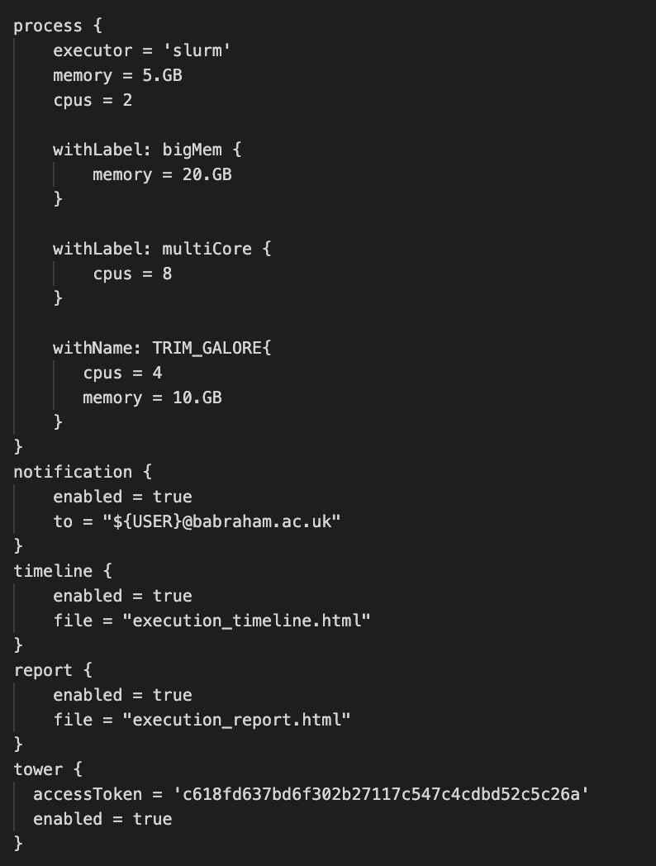
Running pipelines at Babraham
Several options can be defined in config files (global > home > wd)
/bi/apps/nextflow/nextflow_pipelines/nextflow.config
Double hyphen options are user defined parameters (params)
Some modules allow/require specific parameters
Specify genome: --genome <genomeBuild>
List genomes: --list_genomes [--verbose]
Default: auto-detect single-end/paired-end. Force single-end: --single_end
Single hyphen options are Nextflow commands
Each process is carried out in its own working directory, saving history:
allows to -resume a pipeline
Temporarily change parameters: e.g. -process.executor=local
Disconnect from terminal session: -bg (background)

Slide 19

Running pipelines at Babraham
Next steps:
Streamline processes, add cleanup
Function to add new custom genomes
Add more pipelines (Hi-C, allele-specific pipelines, reStrainingOrder …)
Integrate new workflows into automated sequencing processing
Your suggestions, requests!

Slide 20
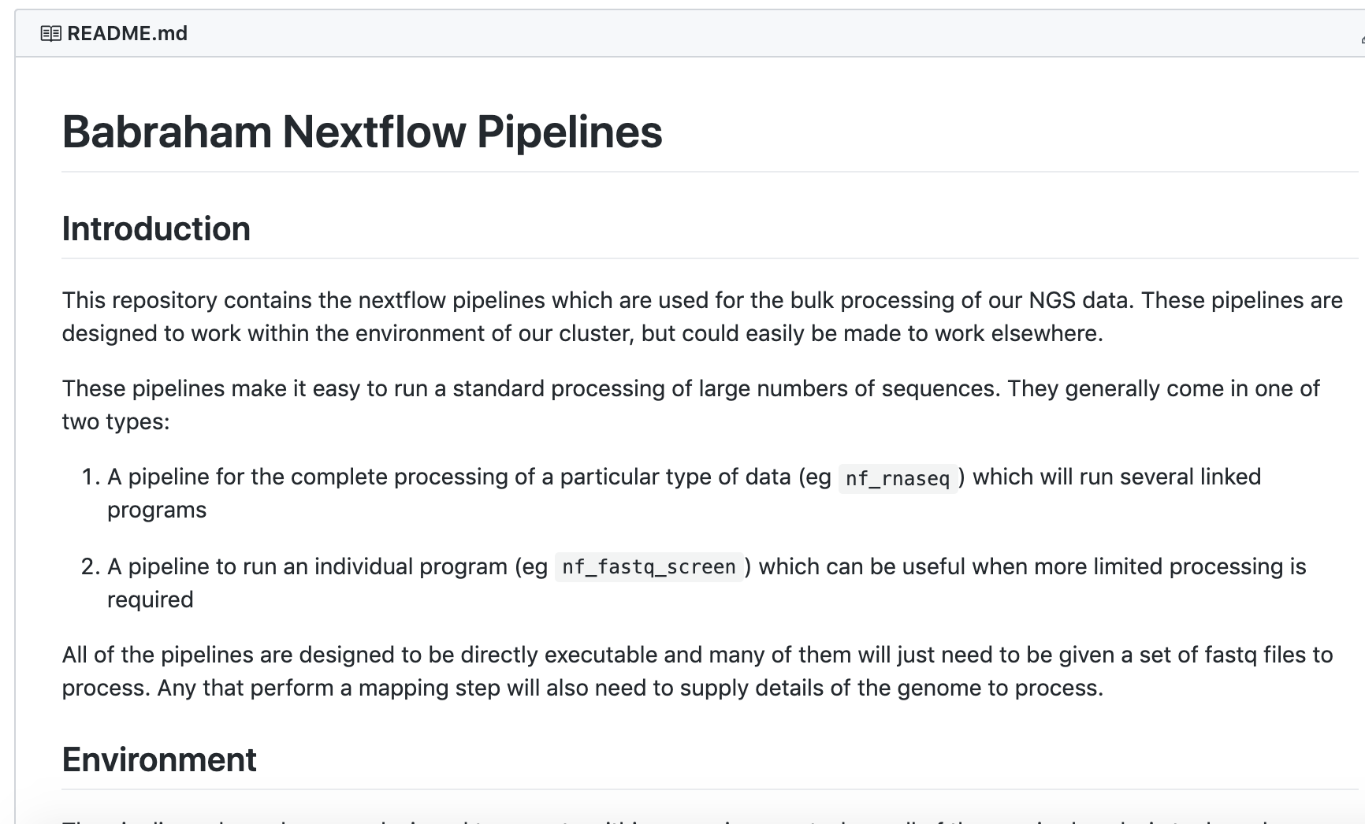
Getting help and further information
Documentation
further details on individual pipelines
Bug reports
requests
https://github.com/s-andrews/nextflow_pipelines
https://www.nextflow.io/
Come and see us or e-mail: babraham.bioinformatics@babraham.ac.uk

Slide 21

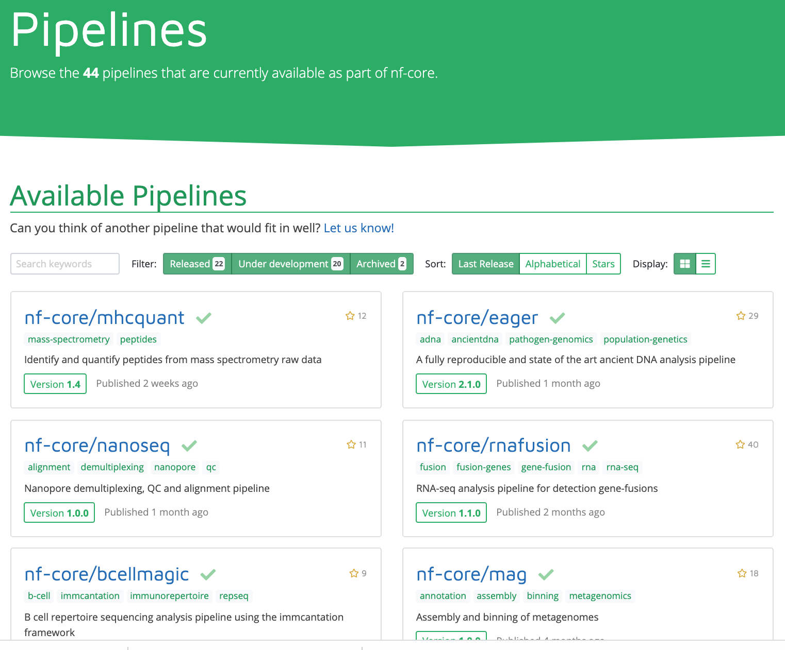
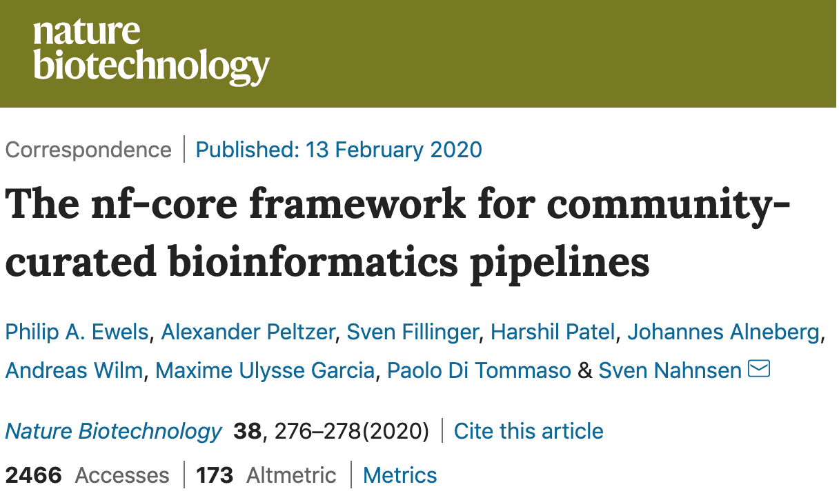
Not enough time to develop your own pipeline? Need inspiration?
https://nf-co.re/

